Slide 1
Blueprint Downtown Steering Committee Meeting
Assembly Chambers
February 20, 2020

Slide 3
Welcome
Roll Call
Approval of Minutes
January 22, 2020
January 30, 2020
Public Participation
Steering Committee Updates
Ken Colon, Juneau Police Department - CPTED
Draft Chapter 4: Economic Development
Public Participation
Committee Comments
Adjournment

Slide 4
Crime Prevention Through Environmental Design CPTED Officer Kenneth Colon

Slide 5
It is a concept that the built environment can have a psychologically deterrent effect on criminal behavior.
CPTED principles are scalable. They can be applied to cities, neighborhoods, commercial property, schools, parks, and individual residences.

Slide 6
Crime Prevention Triangle
Desire
Opportunity
Ability

Slide 7
1. Surveillance
2. Access Control
3. Territoriality
Maintenance (Broken Windows)
All principles must work together to have a deterrence effect.

Slide 8
3 Basic Concepts of CPTED
1. Surveillance(Can someone be seen?)
2. Access Control(Can someone get in and out?)
Territoriality (Does anyone care what happens?
Is there a sense of ownership?)
4. Maintenance

Slide 9
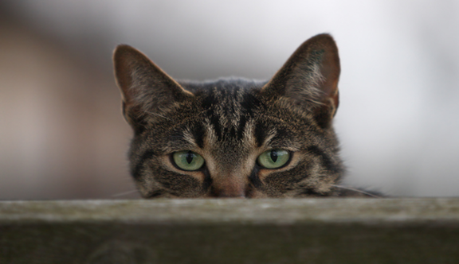
Surveillance
The ability to see and to be seen.
People must be able to see illegal acts taking place to take action to defend property or to prevent crime .
Surveillance puts the offender under threat of being observed, and therefore identified and apprehended.

Slide 10
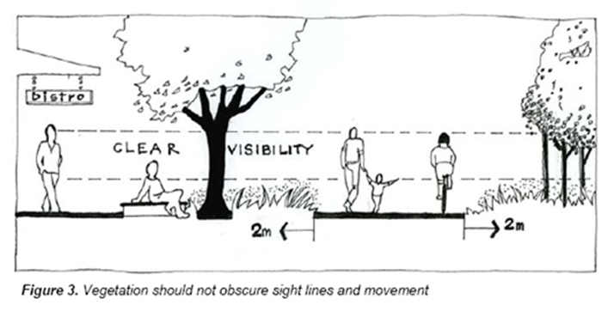
Surveillance
lighting
windows facing streets and alleys
staff to monitor high risk areas
electronic surveillance
window clutter / visual obstructions
see through gates and fences

Slide 11
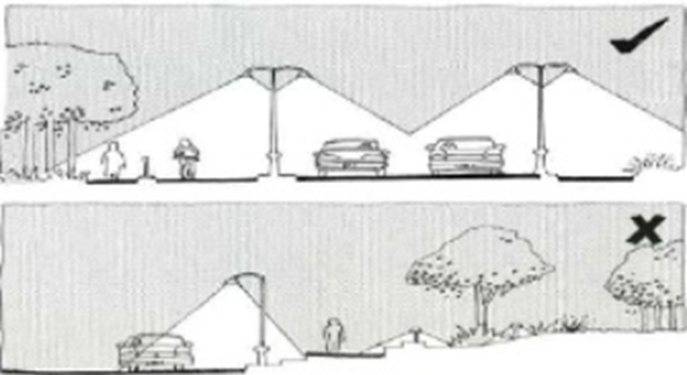
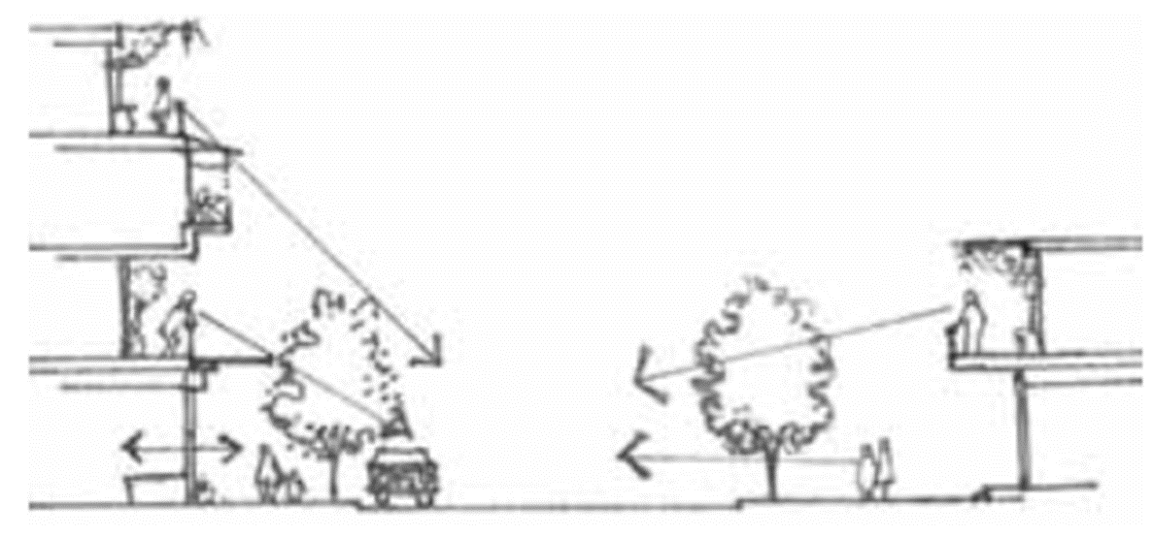
Design to maximize Natural Surveillance.

Slide 12
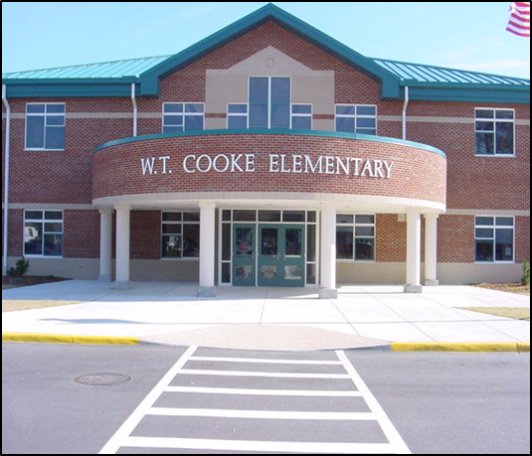
Access Control
Denies or restricts access to targets.
Directs people into specific points that can be more easily watched.
Enhances the ability to be seen.
Increases risks perceived by offenders by controlling or restricting their movement.

Slide 13
Territoriality
Creative Strategies
A clean, organized, well lit area clearly defines a space of ownership and encourages positive social behavior.
People Protect or Defend Space which they occupy

Slide 14
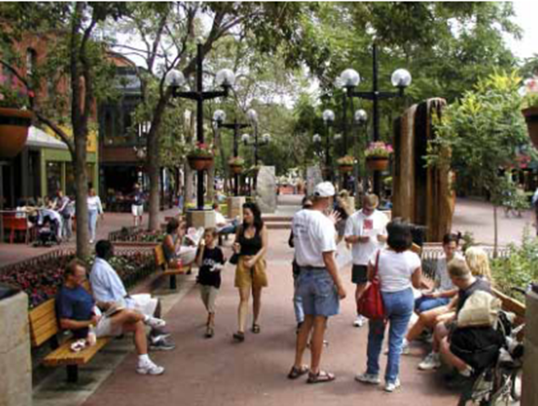
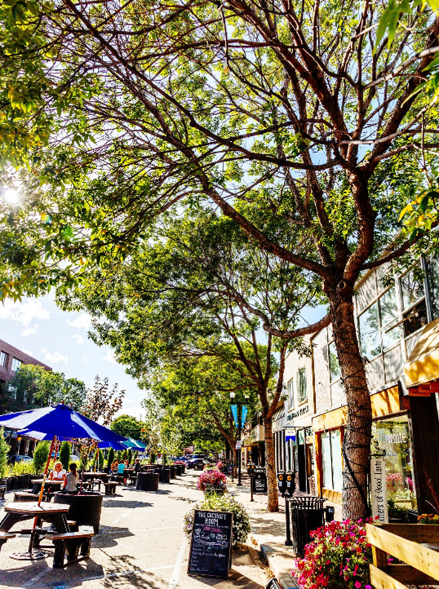
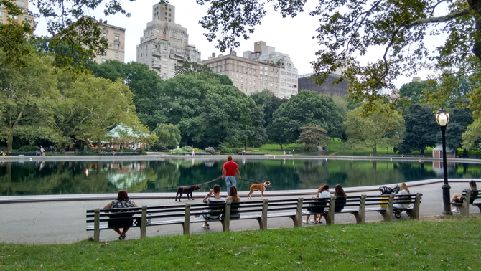

Slide 15
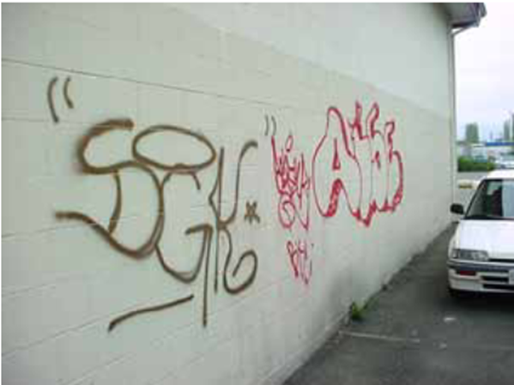
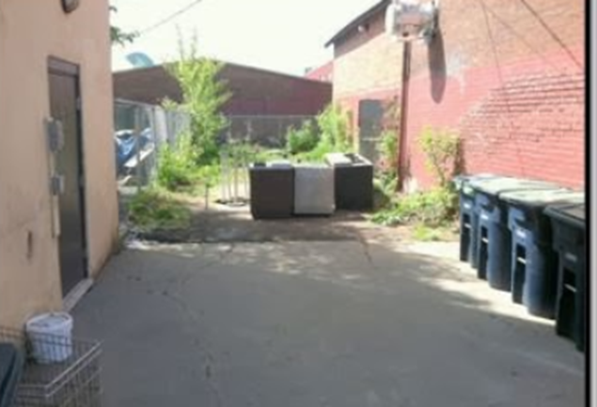
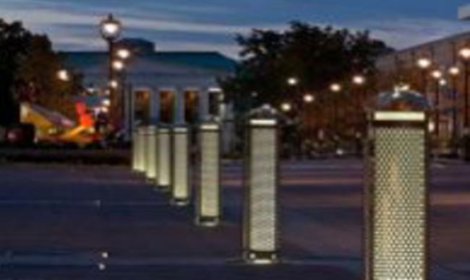

Slide 16
Economic Development
Structured to follow draft table of contents
Incorporates recommendations of previous plans Sections
Review the visioning public concerns/consultant recommendations
Summarized relevant plans reviewed
2013 Comprehensive Plan
2015 Economic Development Plan
2016 Housing Action Plan
1997 Capital City Vision Report
2002 Tourism Management Plan (resolution)
2012 Willoughby District Plan (chapter 5)

Slide 17
Outcome from tonight
Do we want to re-arrange?
What do you want to change?
Anything in existing plans or vision that you particularly want to emphasize/prioritize?
What is missing that you expected to see?
Recommendations will be compilation of what is contained in existing plans but noting what has been addressed
Add any new recommendations from group discussions
More information on specific topics?

Slide 18
Vision Statement
Maintain and strengthen Downtown Juneau as a vibrant, safe and accessible place to live, work, play and explore. As home to the Capitol, Downtown Juneau is a dynamic center of Government and is welcoming and appealing to residents, visitors, innovators and investors. Its unique heritage and history, access to natural beauty and urban amenities, provide opportunities for investment and sustainable growth.

Slide 19
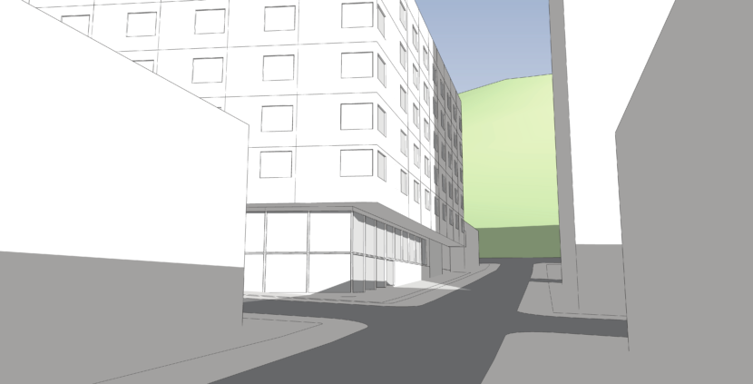
Housing as Economic Development
Change title
What to consider when adding housing
Possible goals –
Develop downtown housing to accommodate an increased and diverse residential population.
Encourage development of a wide range of housing types that are affordable to all incomes and abilities.
Possible actions -
Consider inclusionary zoning requirements for tourism related businesses to ensure new business contribute to the housing needs for their workers
Tax abatement for new value added in downtown for a period of time to incentivize redevelopment (state law allow????)
Seek and assemble resources, including housing fund resources, to coordinate restoration for housing above the retail level within historic buildings.
Possible metrics-
Number of housing units in downtown by area by type, tenure and prices
Number of people living in downtown

Slide 20
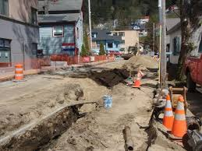
Capital Facilities
CBJ water/sewer
AELP
Other?
Do we want to talk about district heat
Which public buildings did we miss?
What are the capacity of our systems –how much new development can they support?

Slide 21
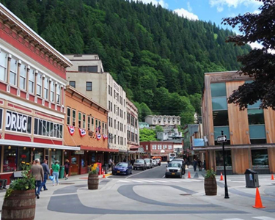
Safe and Welcoming Downtown
What to consider – not everyone has the capacity to control their behavior…
Discuss what ingredients make downtown is a safe and welcoming place for all ages and walks of life.
Possible Goals –
Strengthen partnerships with local business networks, human service providers, and mental health.
Possible Actions –
CPTED
Mainstreet –ambassadors, place making, programing, cleanups etc.
Prioritize clean streets and well-maintained buildings and infrastructure
Possible Metrics-
Crime statistics
Homeless point in time count
Number of blighted properties in downtown

Slide 22
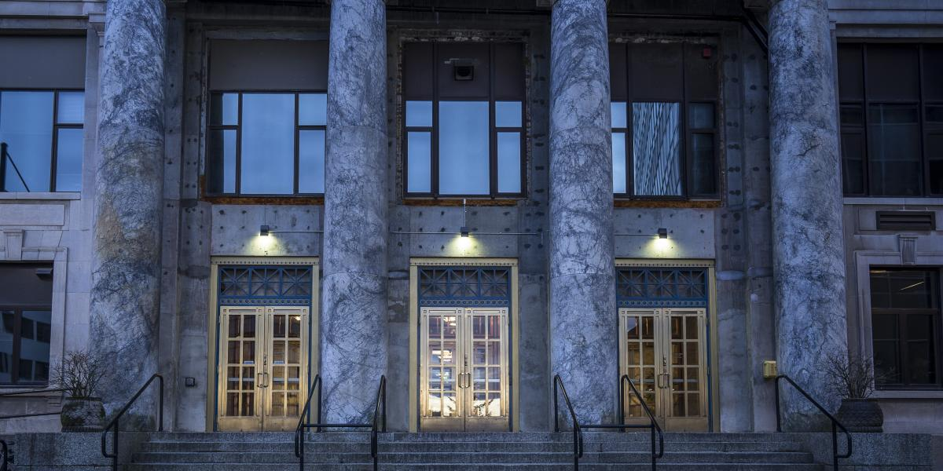
Capital City
Emphasize Juneau as a “Destination” capital city, well-known for its pedestrian-friendly
infrastructure and successful long-term planning.

Slide 23
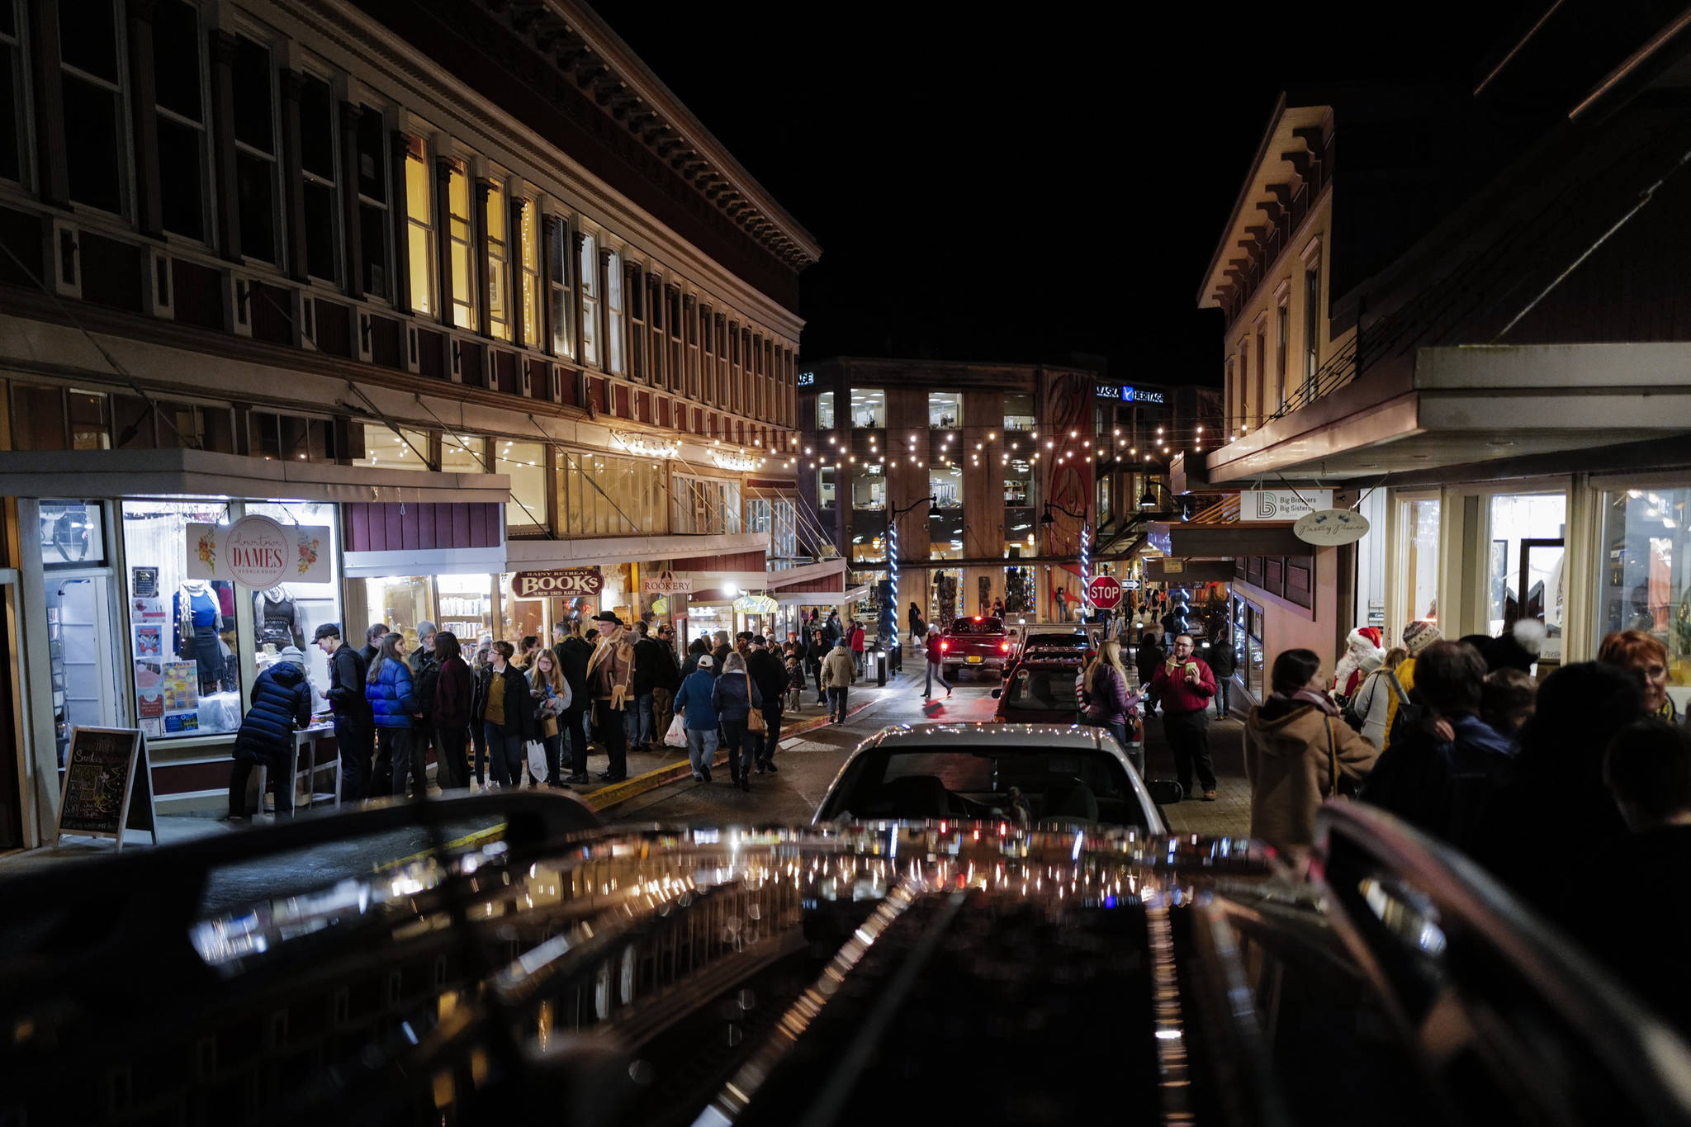
Business Vitality (1)
What are you interested in seeing here?
Year round businesses
Diversity of retail type
Possible metrics -
Dollars of new investment activity in downtown
Retail sales activity in downtown
Number of businesses in area – recommended in Economic Development Plan
Number of vacant properties in area – recommended in Economic Development Plan
Dollar property tax revenue from area – recommended in Economic Development Plan
Dollar sales tax revenue from area – recommended in Economic Development Plan
Increased property value and related taxes in downtown following new construction, redevelopment or rehabilitation

Slide 24
Business Vitality (2)
Possible Actions -
Create a downtown improvement district as with a revenue stream to fund activities, upgrades, and other incentive for people to live and shop downtown
Seek and assemble resources, including housing fund resources, to coordinate restoration for housing above the retail level within historic buildings.
Develop historic preservation opportunities,
Tax abatement for new value added in downtown for a period of time to incentivize redevelopment (state law allow????)
Preferential business loans that require the business to operate in the downtown?
Other incentives for rehabilitation?
New business development grants

Slide 25
Mainstreet

Slide 26
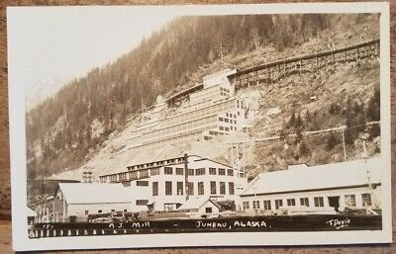
AJ Mine
Did not come up through visioning work
Comp Plan - 5.13 – IA2 Develop a five-year Action Plan for the sustainable development or long-term maintenance of the CBJ’s AJ mine property. The plan should address potential economic, environmental, and social impacts of the City’s AJ mine property with or without development and describe actions the City should take to accomplish either objective.
Considerations – drainage, water supply, mine design, time line for activation, transportation, etc.

Slide 28
Next Meeting Dates:
Thursday- March 12, 2020, Assembly Chambers
Thursday – April 2, 2020, Assembly Chambers

